Slide 1

File Upload Bugs
Notes:
In this session, we’re going to talk about file upload vulnerabilities. I’ve mentioned these on quite a few occasions thus far. They’re interesting because there are a whole host of ways they can be handled improperly, allowing for XSS, code execution, arbitrary file writes, header splitting, and many other bugs.

Slide 2
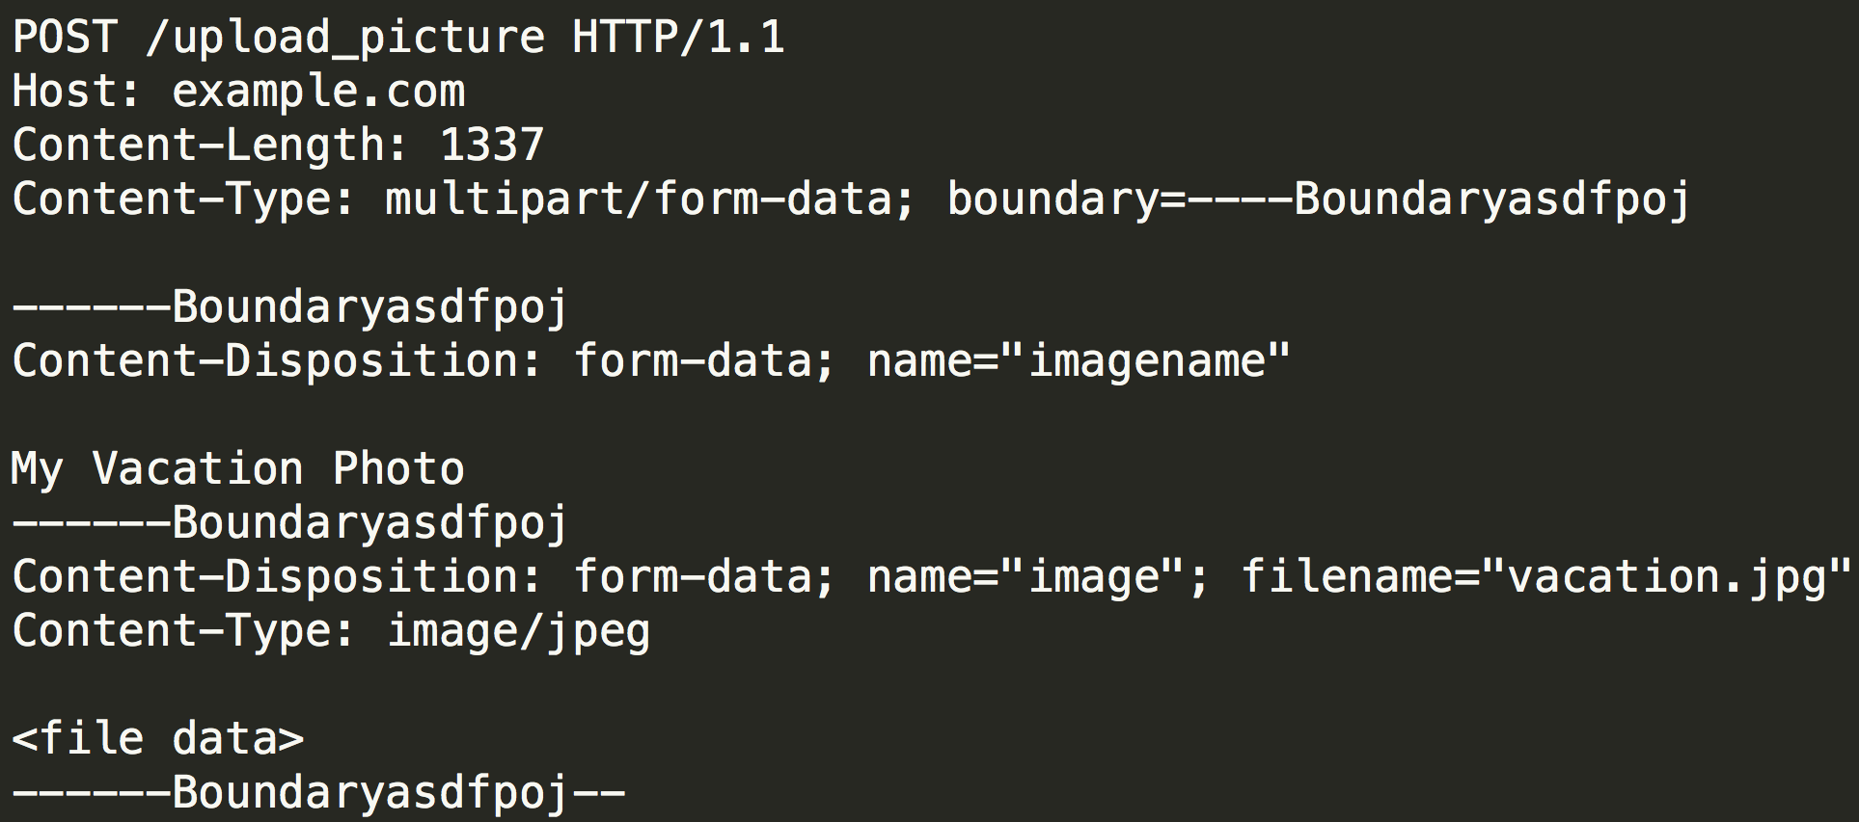
What They Are
Notes:
Many people have never seen a file upload, so I think it warrants some attention. The head of the request looks like most POSTs. The difference is that you have a multipart content type, which specifies a boundary. From there, you have separate components specifying each individual form element. In the case of the file itself, it sends up the file data along with original filename and the browser’s guess for the MIME type.

Slide 3
Filenames
The most obvious way to break this is via the filename. If you see an uploaded file retain the original filename -- or a derivative thereof -- chances are good that you can manipulate it.
For instance, directory traversal works well here. What if you upload a file called “../../test.php”?
Notes:
Often, only the extension is kept, which complicates exploitation but does not stop it.

Slide 4
MIME Types
Often, the MIME type sent by the browser on file uploads is stored in a database along with the uploaded filename and associated metadata.
If this is sent down with the file when it’s accessed, this can allow things like XSS. For instance, you could upload an HTML file disguised with an image filename, and send text/html as the MIME type. Upon access, the browser will parse it like normal.

Slide 5
Sniffing
When uploading images in particular, many sites will attempt to validate that the file is an actual image, then allow it to pass through with no modification.
The problem is that even if the file is a valid image, it can still contain malicious content, e.g. HTML.

Slide 6
Sniffing
PNG files, for instance, can contain arbitrary ‘chunks’ that are completely valid and ignored by the file loader. This allows you to embed any HTML into a PNG while maintaining a completely proper file.
Depending on filename and MIME type sent by the server, the browser could decide to parse it purely as HTML, rather than an image, leading to XSS.

Slide 7
Mitigation
So given the breadth of issues here, it’s clear that one single mitigation isn’t going to fix it all.
Let’s break this down one by one and talk about common mitigations and how they can fail.

Slide 8
Separate Domains
In the vast majority of cases, files uploaded by users should be hosted on a separate domain. The reason for this is that if you don’t do that, same-origin policy comes into play, and it’s possible for Javascript running in the context of the domain to manipulate the site, get cookies, etc.
This does not solve any of the issues directly, but it does give you insurance if your other mitigations fail.

Slide 9
Generated Filenames
Filenames should never come from a user directly. When you receive a file upload, a filename should be generated randomly (or via a hash of file contents + timestamp, for instance) with an extension based on MIME type or detected file type.
Note that the extensions should be whitelisted. You don’t want people uploading HTML or other malicious content!

Slide 10
Type and Disposition
If the uploaded files are not being served directly from the filesystem, then the issue becomes: what MIME type and content disposition do we use?
The general rule is that MIME types should be whitelisted. If you want to allow types that are not on the list, the content disposition should be set to ‘attachment’. That will force the browser to download the file, rather than display it.

Slide 11
Image Stripping
If you’re handling only images, then removing EXIF data from JPEGs, ancillary chunks from PNG files, and all other extraneous data is always a good idea.
The reason for this is that those are great hiding spots for HTML, and while there may not be a way to get the browser to load your image as HTML today, that can easily change tomorrow.
Removing this data is the only safe route.

Slide 12
Generalized
The most important thing to remember when dealing with file uploads is: the user cannot be trusted. Whenever possible, get rid of any non-essential data that the user provides you.
If you’re handling images, nothing but the actual image data matters. If you’re handling archive files, unpack them and repack them to ensure that nothing malicious is in the archive structure itself.

